Slide 1
UI Design
Summer Camp 2016
Sul Ki Park Department of Computer Science Software Engineering Laboratory (SELAB) Soongsil University psk9314@gmail.com

Slide 2
UI Navigation
Login Page
Main Page
Stress Most Recent
Stress Most Recent
Stress Most Recent
B.Age Most Recent
Stress Recent Week
B.Age Recent Week
Stress Recent Month
B.Age Recent Month
Stress Recent Year
B.Age Recent Year

Slide 3


Layout

Slide 4
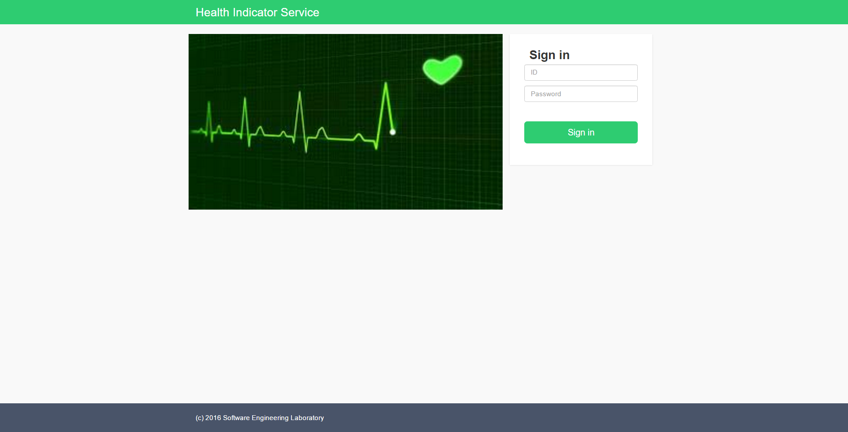
Log In Page

Slide 5
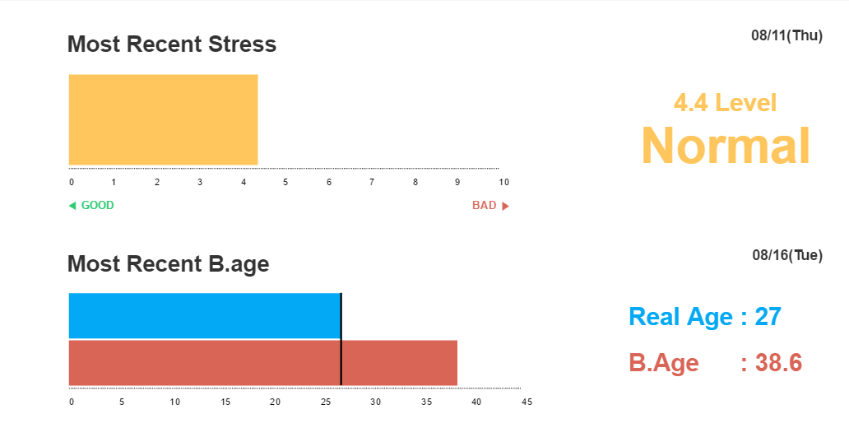
Main

Slide 6
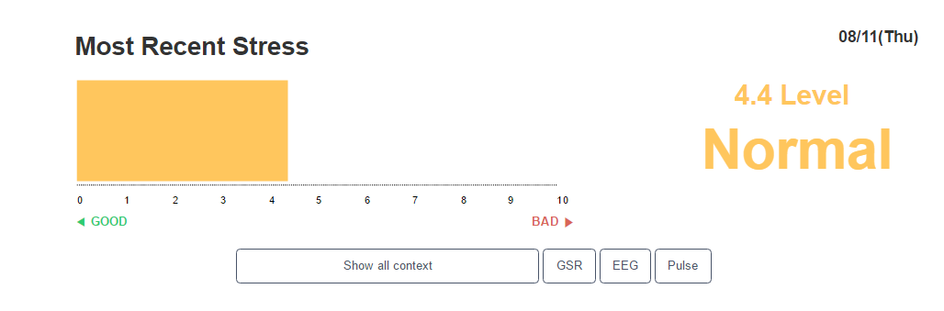
Stress Most Recent

Slide 7
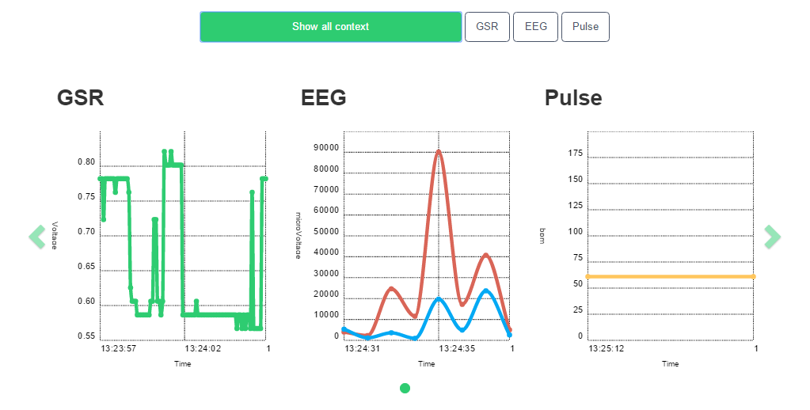
Stress Most Recent Context - All

Slide 8
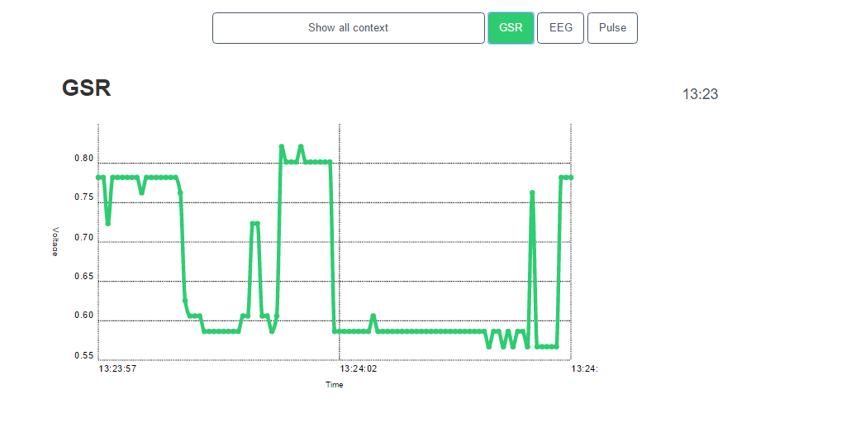
Stress Most Recent Context - GSR

Slide 9
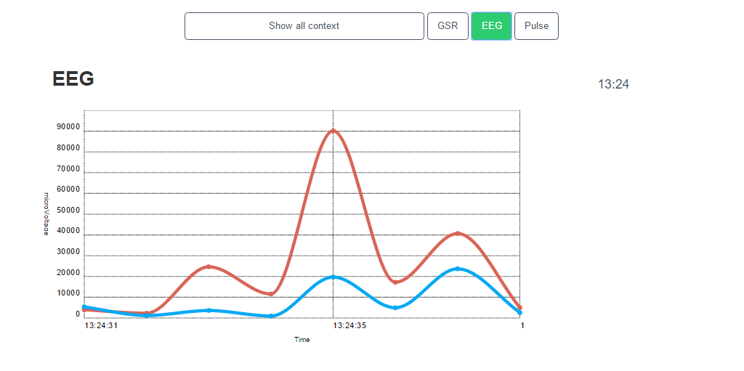
Stress Most Recent Context - EEG

Slide 10
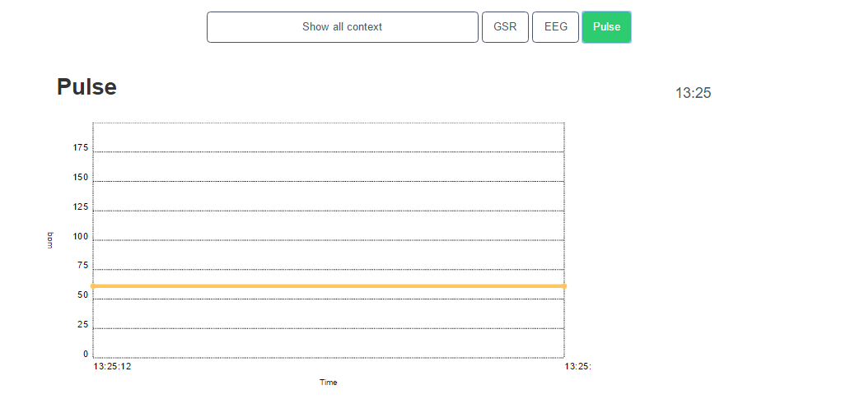
Stress Most Recent Context - Pulse

Slide 11
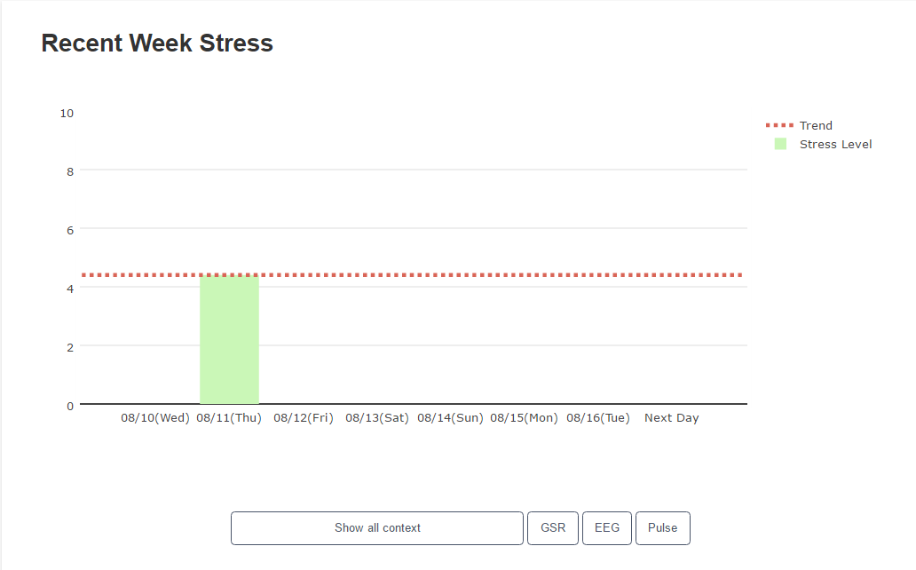
Stress Recent Week

Slide 12
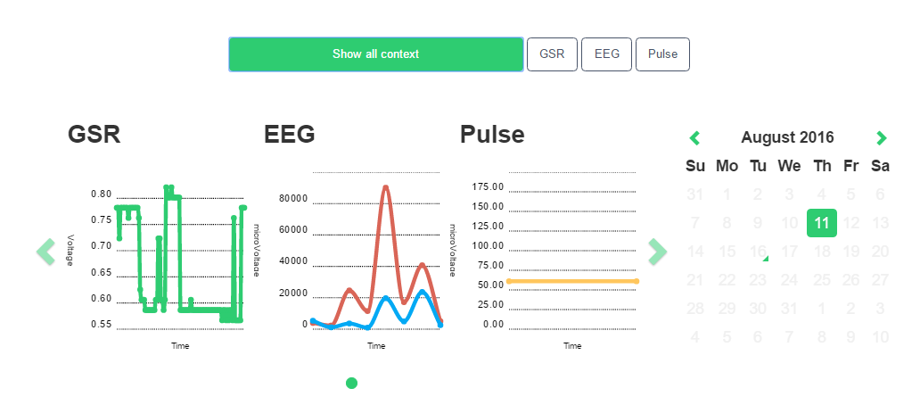
Stress Recent Week Context - All

Slide 13
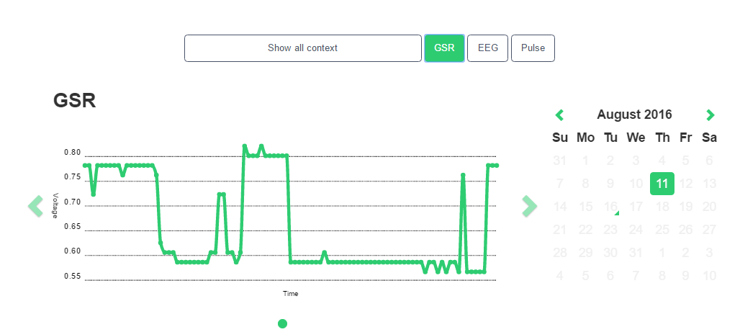
Stress Recent Week Context - GSR

Slide 14
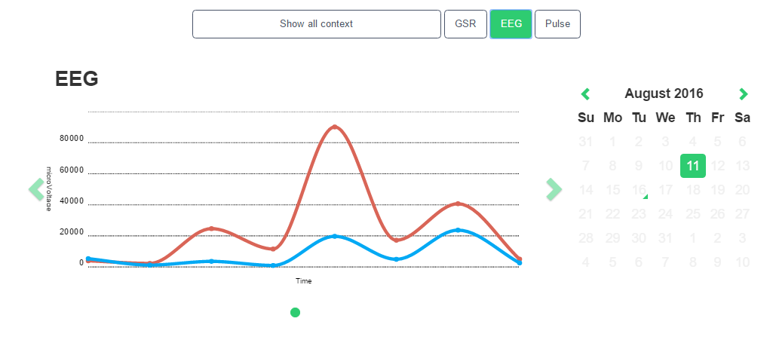
Stress Recent Week Context - EEG

Slide 15
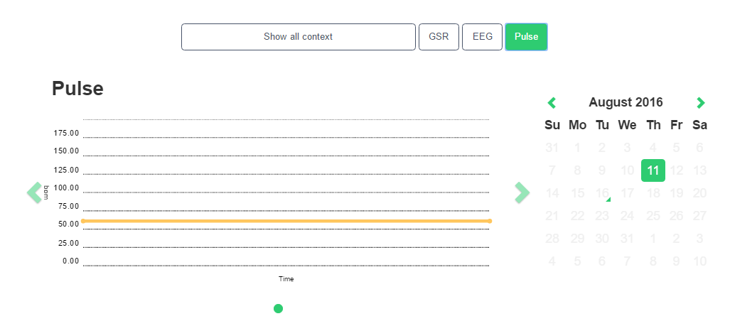
Stress Recent Week Context - Pulse

Slide 16
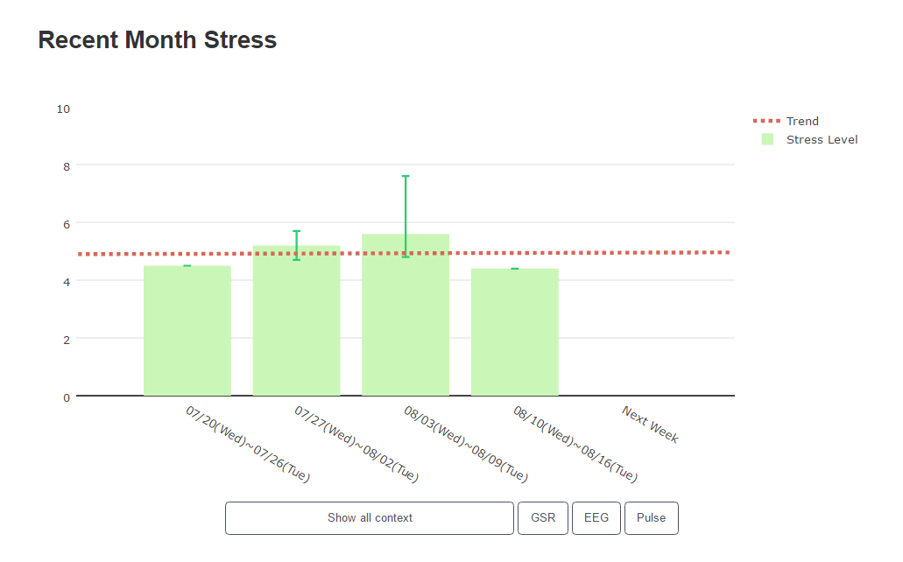
Stress Recent Month

Slide 17
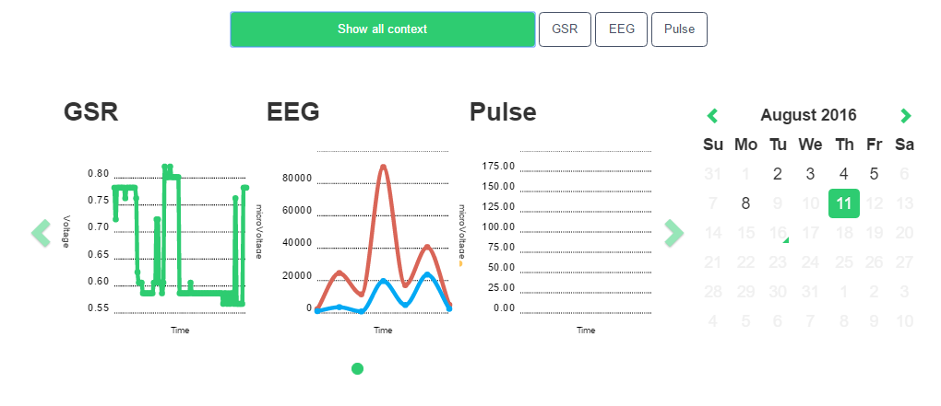
Stress Recent Month Context - All

Slide 18
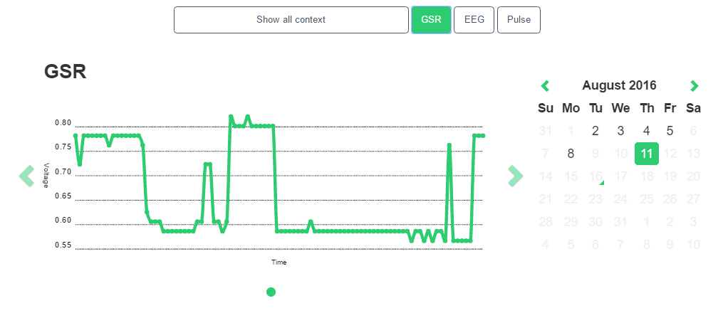
Stress Recent Month Context - GSR

Slide 19
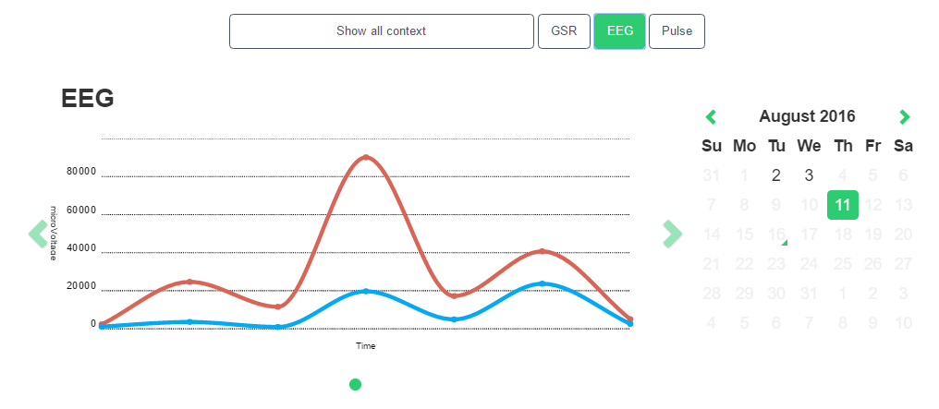
Stress Recent Month Context - EEG

Slide 20
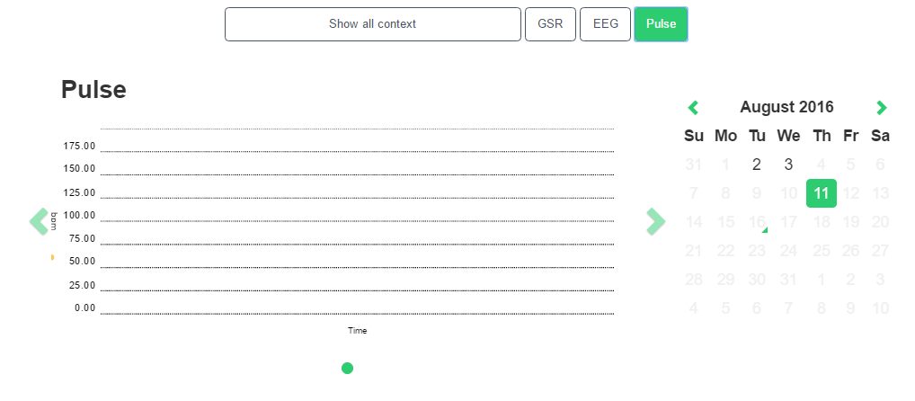
Stress Recent Month Context - Pulse

Slide 21
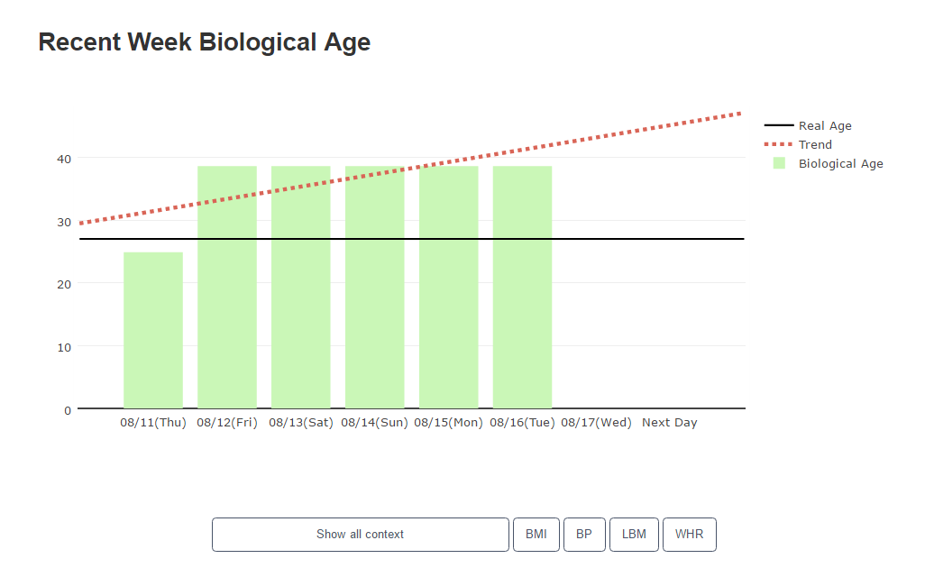
Biological Age Recent Week

Slide 22
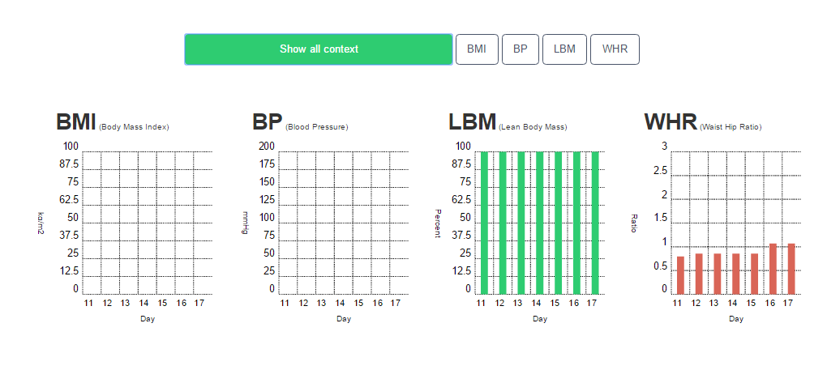
Biological Age Recent Week Context - All

Slide 23
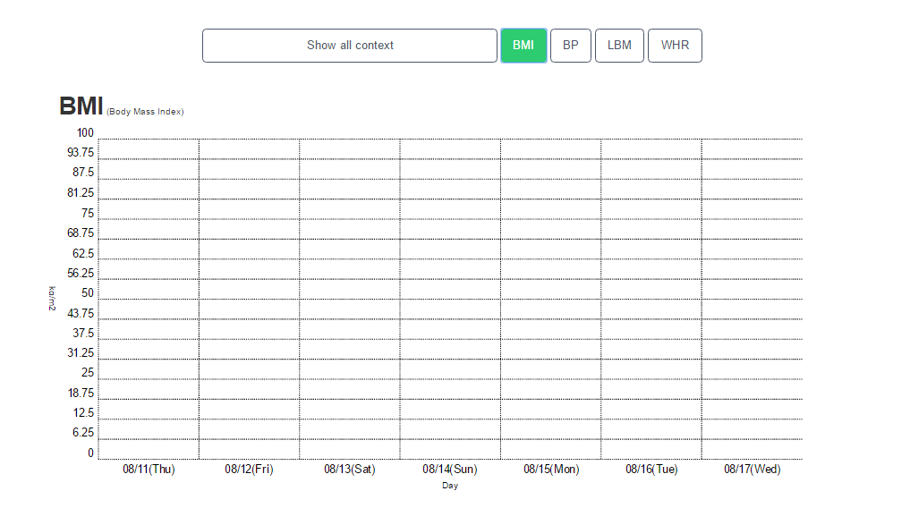
Biological Age Recent Week Context - BMI

Slide 24
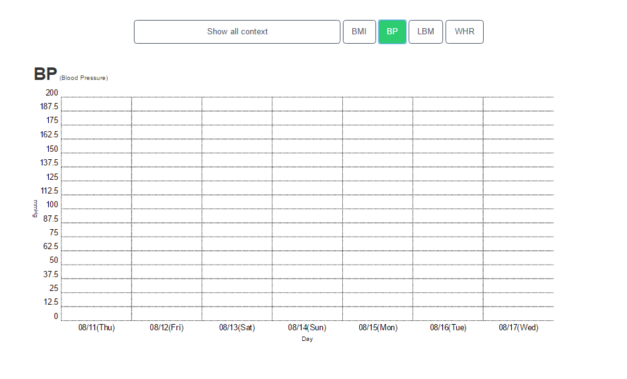
Biological Age Recent Week Context - BP

Slide 25
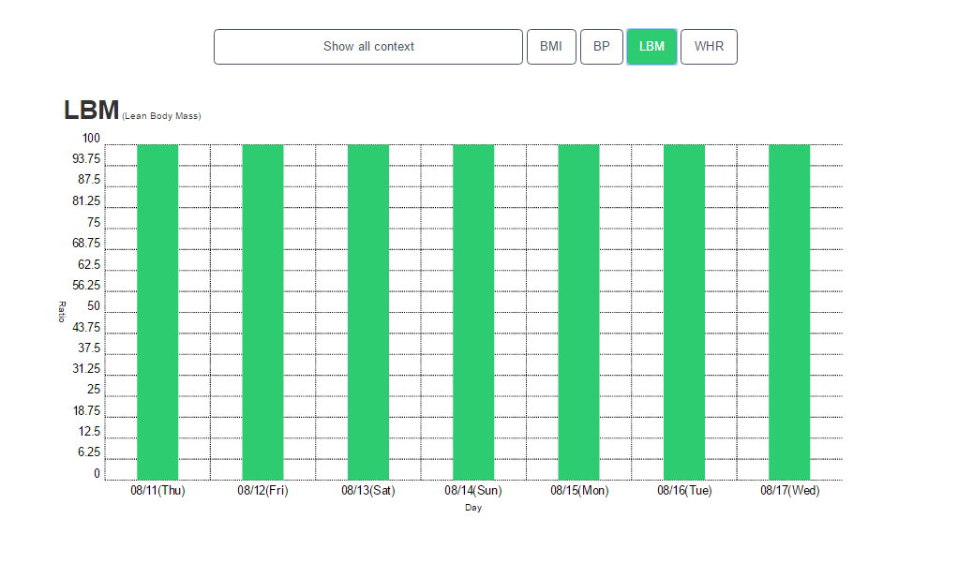
Biological Age Recent Week Context - LBM

Slide 26
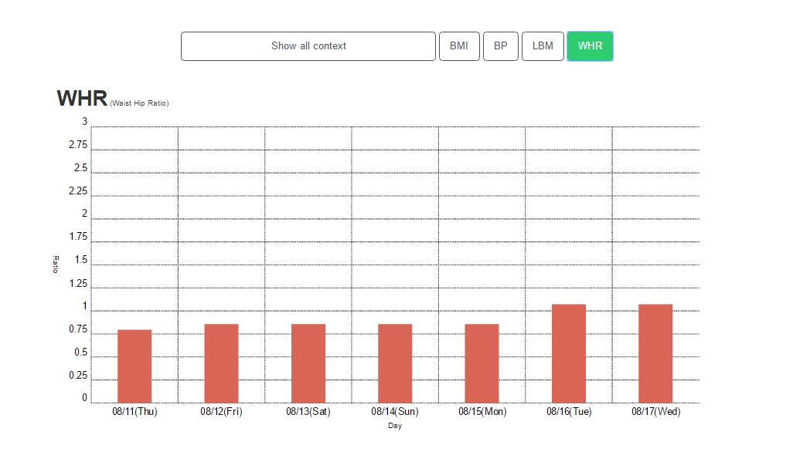
Biological Age Recent Week Context - WHR

Slide 27
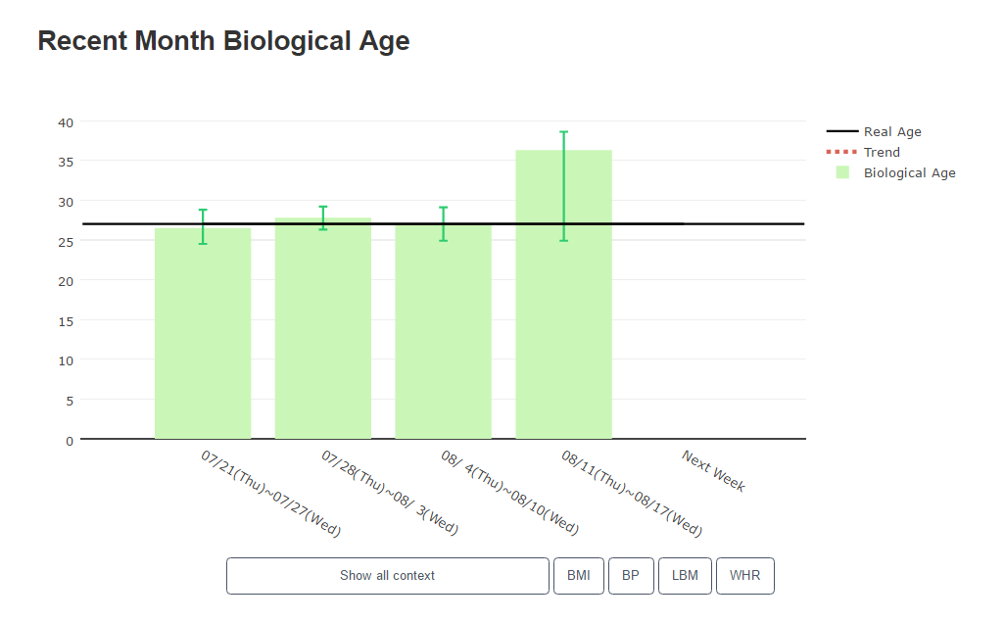
Biological Age Recent Month

Slide 28
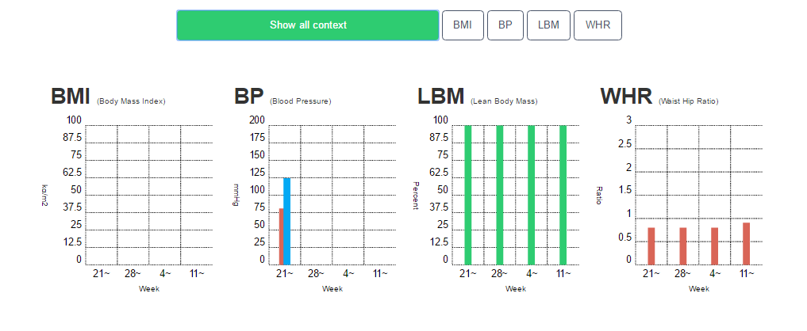
Biological Age Recent Month Context - All

Slide 29
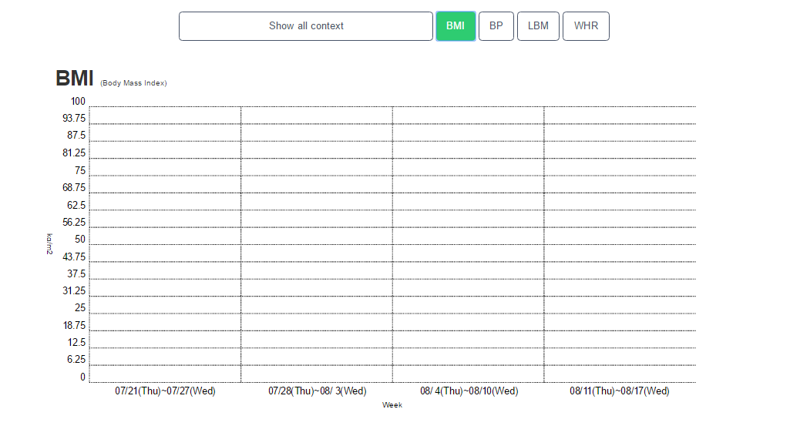
Biological Age Recent Month Context - BMI

Slide 30
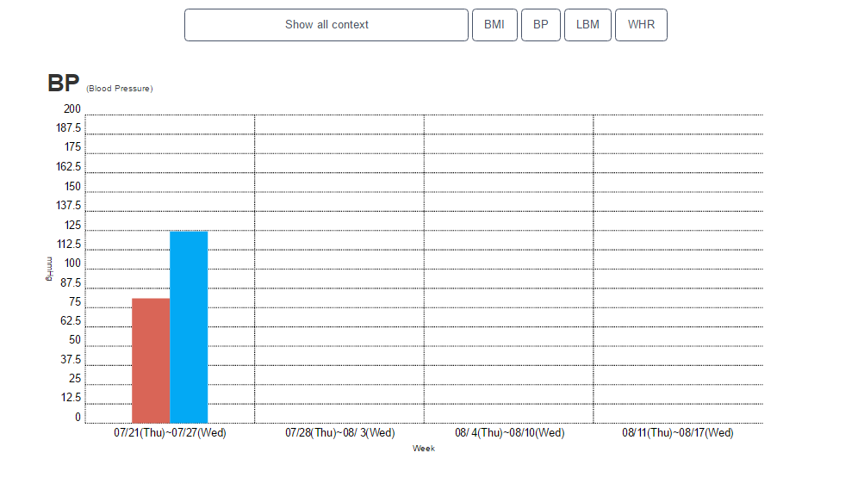
Biological Age Recent Month Context - BP

Slide 31
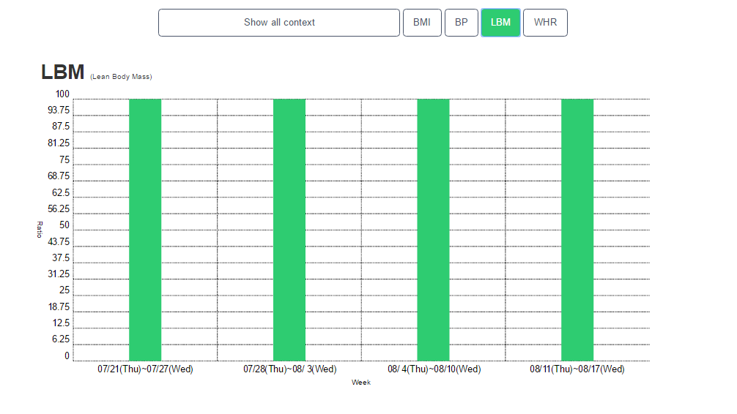
Biological Age Recent Month Context - LBM

Slide 32
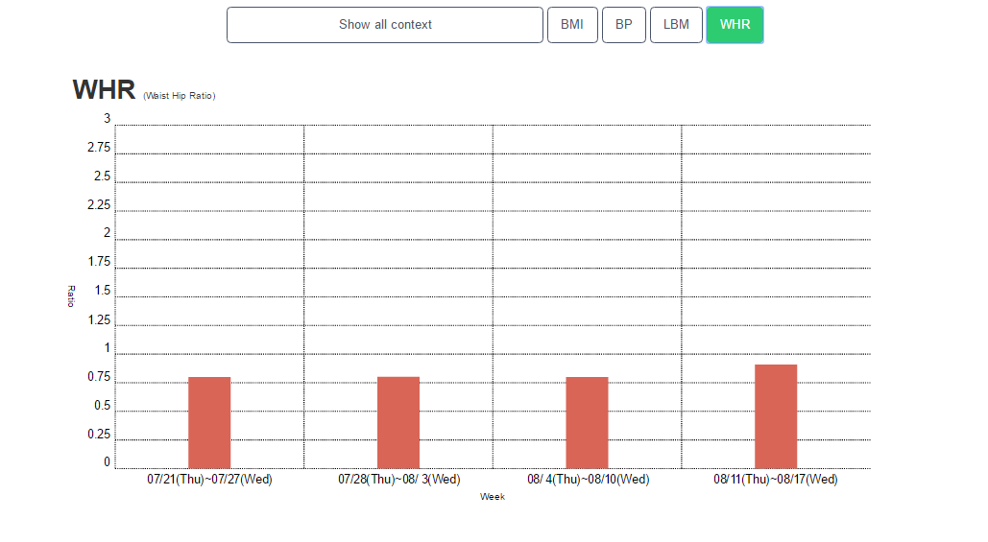
Biological Age Recent Month Context - WHR

Slide 33
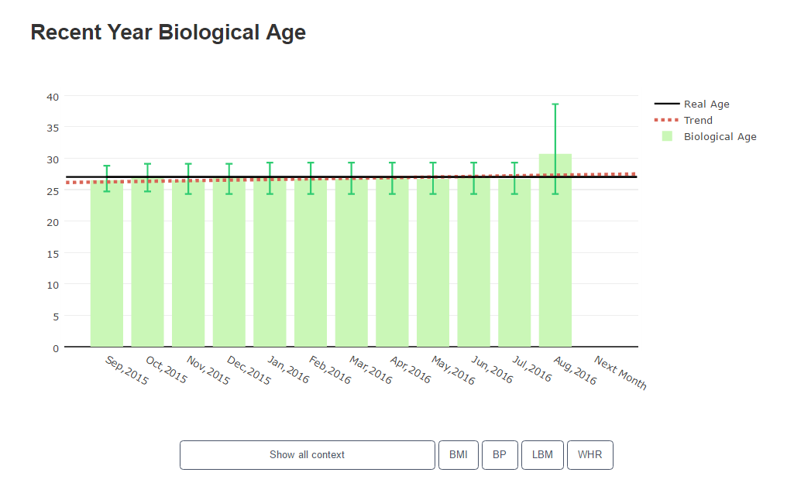
Biological Age Recent Year

Slide 34
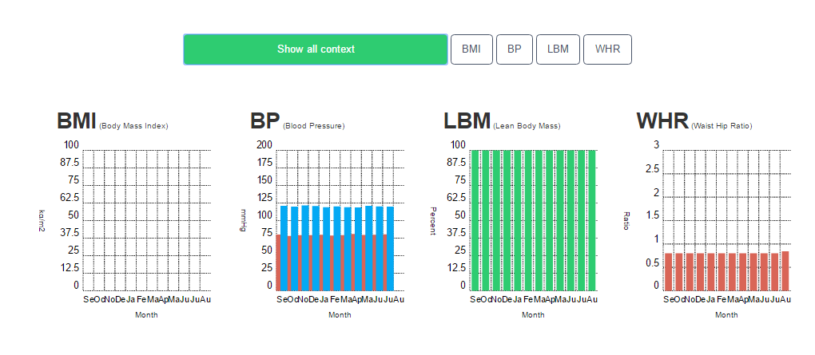
Biological Age Recent Year Context - All

Slide 35
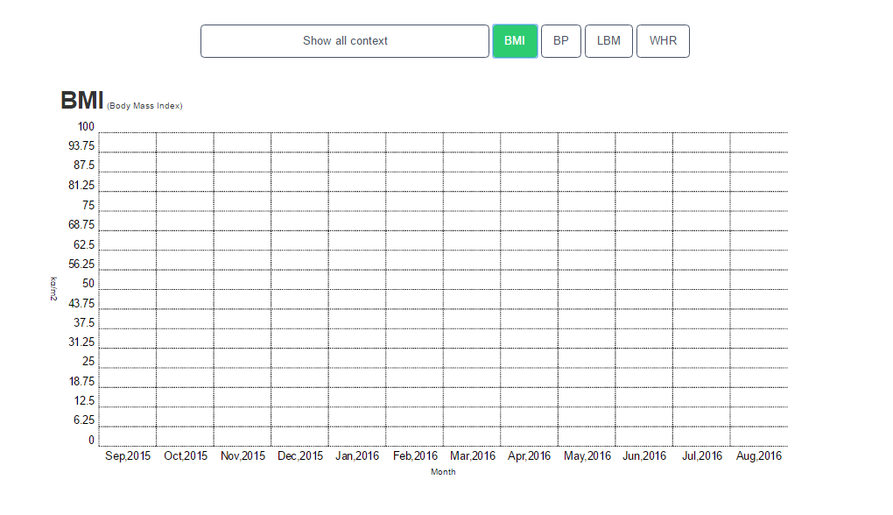
Biological Age Recent Year Context - BMI

Slide 36
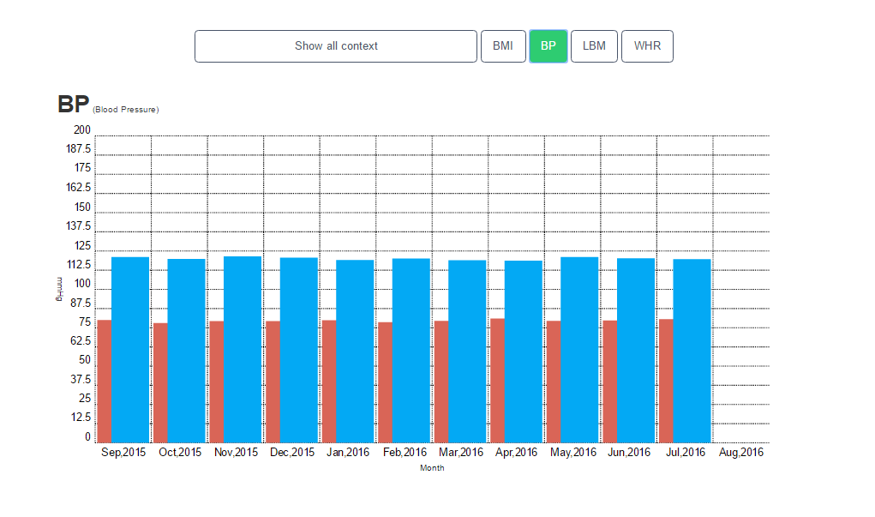
Biological Age Recent Year Context - BP

Slide 37
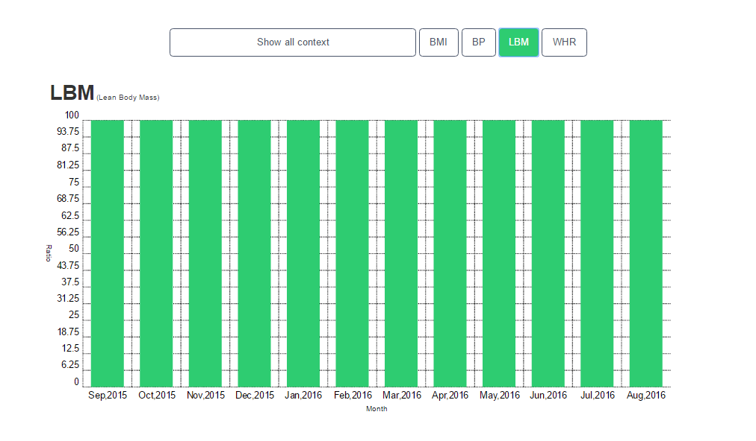
Biological Age Recent Year Context - LBM

Slide 38
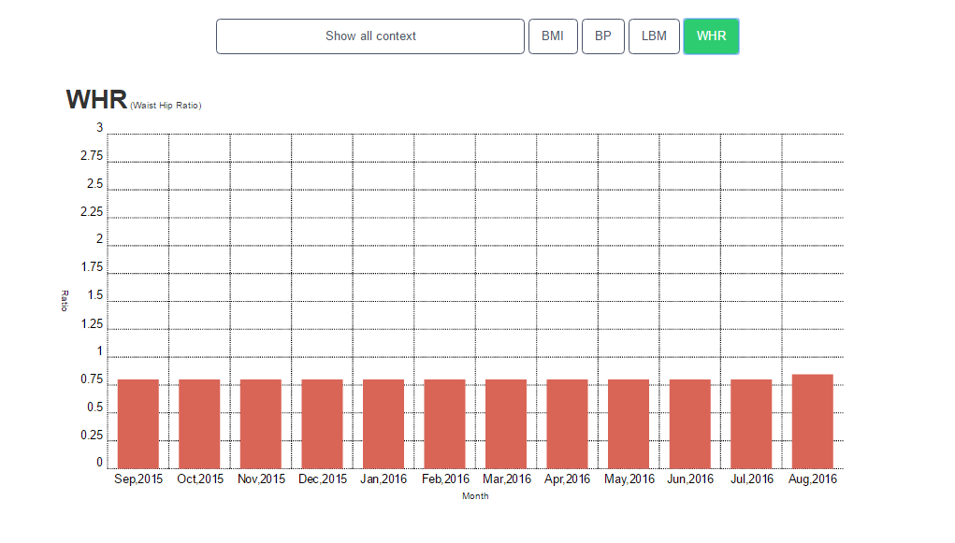
Biological Age Recent Year Context - WHR

Slide 39
Thank You !

